Slide 1
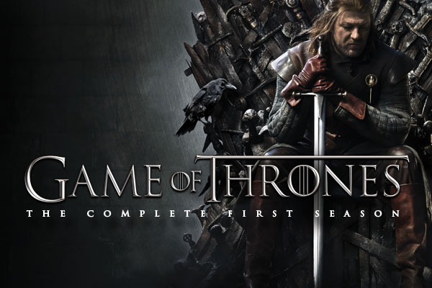

Slide 2
Question no. 1
What is the name of Jon’s dire wolf
A) Lord
B) Ghost
C) Lady
D) Alfred

Slide 3
Question no. 1
What is the name of Jon’s dire wolf
B) Ghost

Slide 4
Question no. 2
Which actor/actress has the most Episode appearances?
A) Dinklage
B) Harrington
C) Clarke
D) Sophie

Slide 5
Question no. 2
Which actor/actress has the most Episode appearances?
B) Dinklage

Slide 6
Question no. 1
What is the name of Jon’s dire wolf
A) Lord
B) Ghost
C) Lady
D) Alfred

Slide 7
Question no. 1
What is the name of Jon’s dire wolf
B) Ghost

Slide 8
Question no. 1
What is the name of Jon’s dire wolf
A) Lord
B) Ghost
C) Lady
D) Alfred

Slide 9
Question no. 1
What is the name of Jon’s dire wolf
B) Ghost

Slide 10
Question no. 1 (No Option)
How many episodes does Game of Thrones have

Slide 11
Question no. 1 (No Option)
How many episodes does Game of Thrones have
73

Slide 12
Question no. 1 (No Options)
What is the main religion of the seven kingdoms?

Slide 13
Question no. 1 (No Options)
What is the main religion of the seven kingdoms?
Faith of the Sevens

Slide 14
That’s all folks!
Relax, see you not for mind

